Slide 1
Monte Carlo simulation
……for better yield and performance
--A tutorial

Slide 2
Monte Carlo simulation
……for better yield and performance
start
System requirement
If fabrication process parameter and device mismatch effect on same die are not taken in to account then→
Initial design
Statistical analysis include process, mismatch effects
Some design may degrade in performance
Overall design yield could be unexpectedly low
Design meets the goal ?
Hence statistical analysis must find a high place in design cycle
NO
YES
end

Slide 3
Monte Carlo simulation
We will perform Monte Carlo analysis on an RF-front end LNA and compare the result if no statistical analysis is done.
We will also see how to analyze yield and scalar data in Monte Carlo with the help of Low pass filter example.

Slide 4
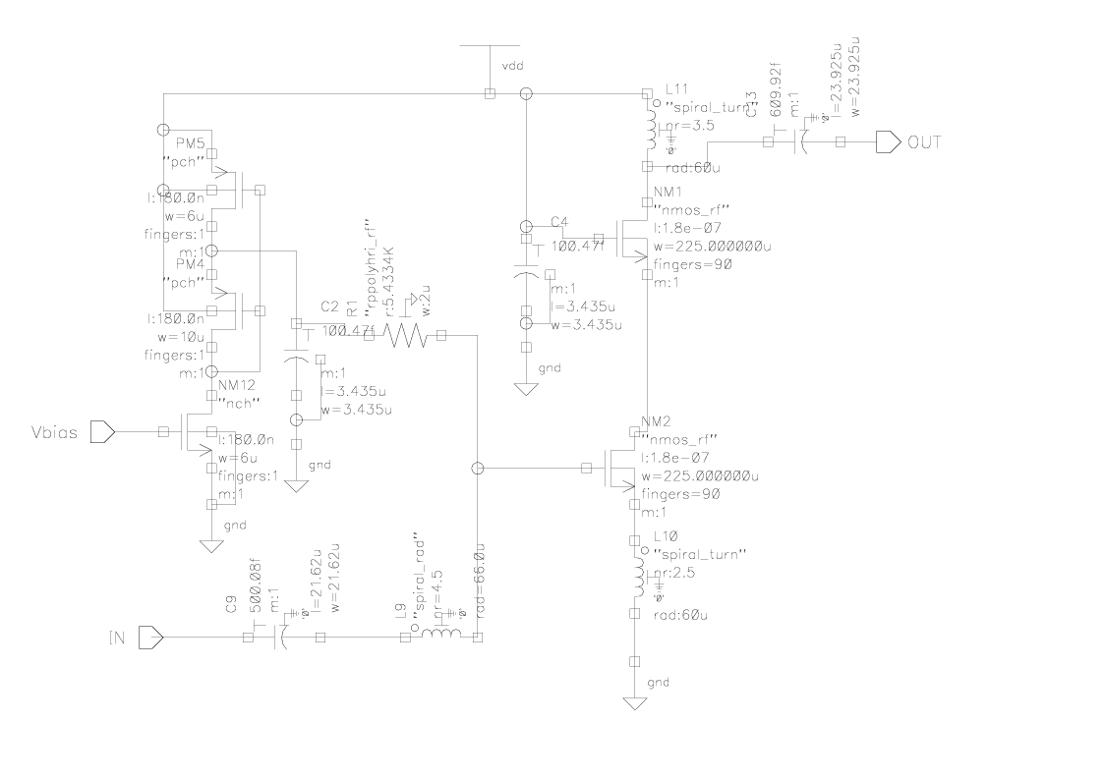
Monte Carlo simulation(example)
RF-front end (LNA)
Knowing System requirement
Initial design based on requirement like noise,gain,narrow or wide band.
Bias N/W
Output matching
Input matching
Cascode arch.to reduce feedback capacitance
Linearity

Slide 5
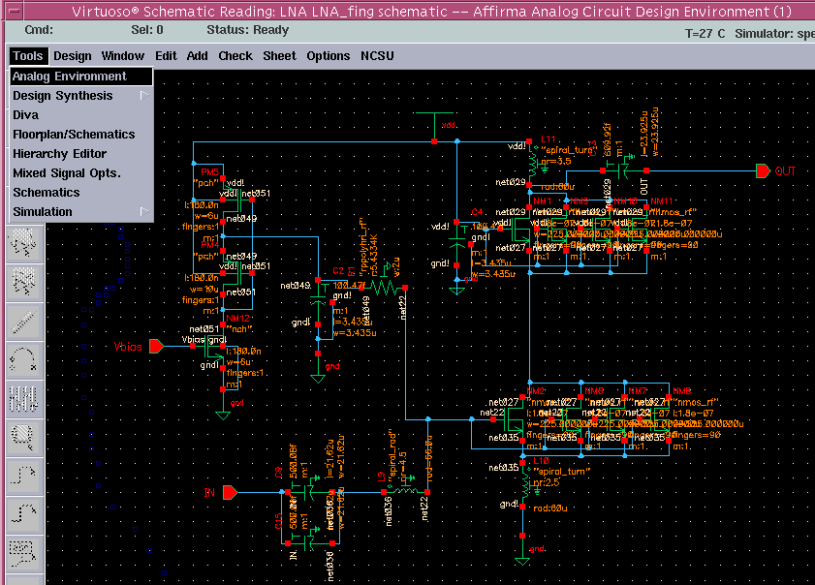
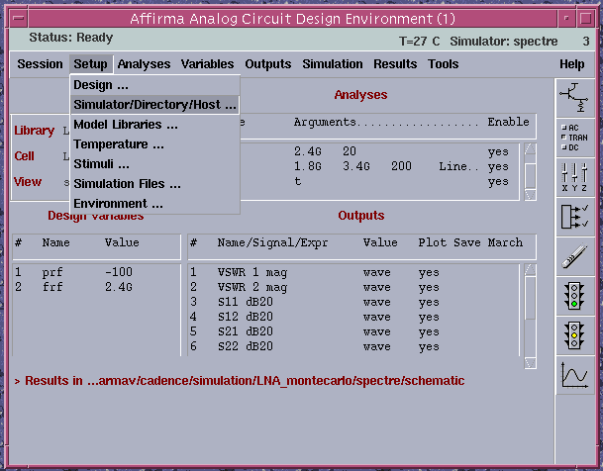
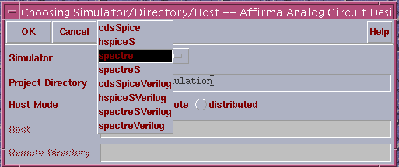
Monte Carlo simulation
Choosing affirma analog artist
2. Choosing Spectre simulator
Cadence simulation setup (Normal)

Slide 6
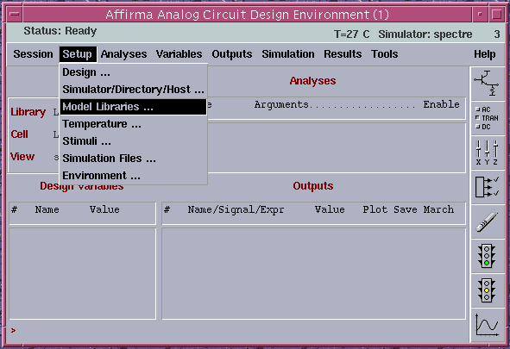
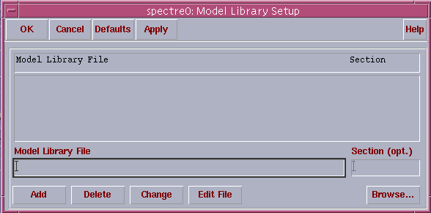
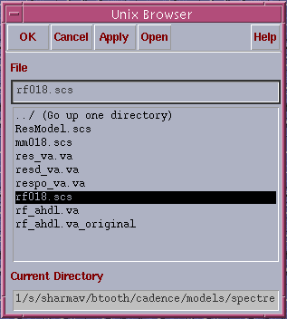
Monte Carlo simulation
1.Choose setup→ model libraries
2.Browse and choose model file in the directory
Choosing model file,which contains all MOS,reg.,cap model parameters.
Cadence simulation setup (Normal)

Slide 7
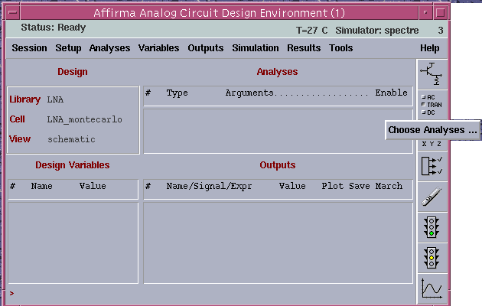
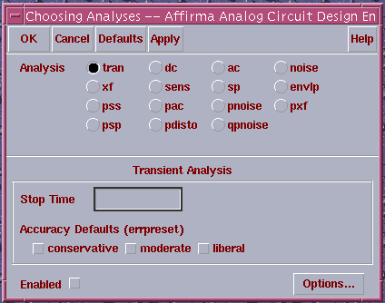
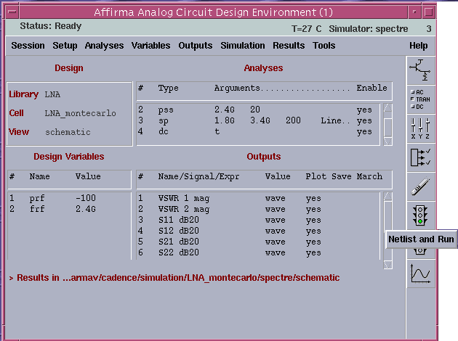
Monte Carlo simulation
1.Choose analysis to run
2.Choose output to plot
3.Create netlist and run
Set up analysis(dc,ac,sp etc.),create netlist and run simulator
Cadence simulation setup (Normal)

Slide 8
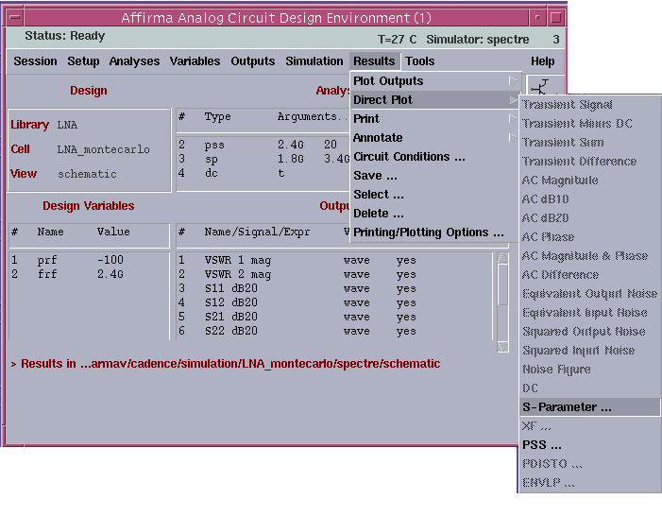
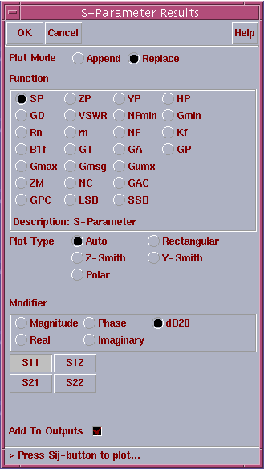
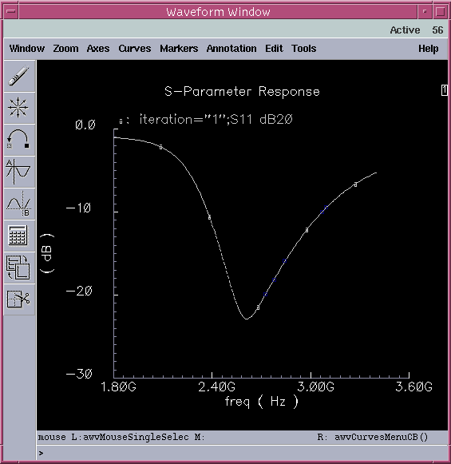
Monte Carlo simulation
Plotting results
1.Choose direct plot for analysis
2.Click to view the desired result
3.Analyze waveform
Cadence simulation setup (Normal)

Slide 9
Monte Carlo simulation
Monte Carlo modeling in Cadence spectre simulator
Process Section - describes manufacturing parameter,their statistical variation and a model for device that calculates its(width,length,cap,res. Etc.)according to process parameter.
Design- Specific Section – designer according to his need can specify Monte Carlo analysis.For example in a current mirror circuit,matched transistors are used and designer can give some correlation factor between these matched transistor.
Cadence simulation setup (Monte Carlo)

Slide 10
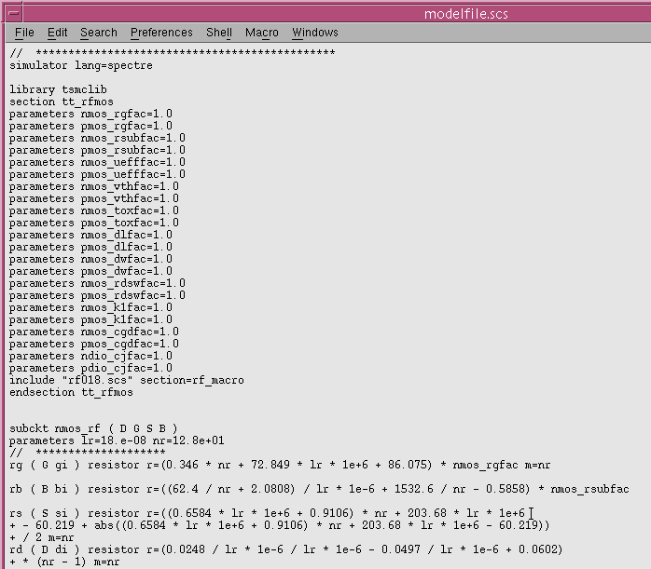


Monte Carlo simulation
Typical Model File
Process Section
1
All parameter sets to their nominal value ,no statistical variation defined
Model (NMOS’s Rg) is calculated using nominal parameter value
2
Cadence simulation setup (Monte Carlo)

Slide 11
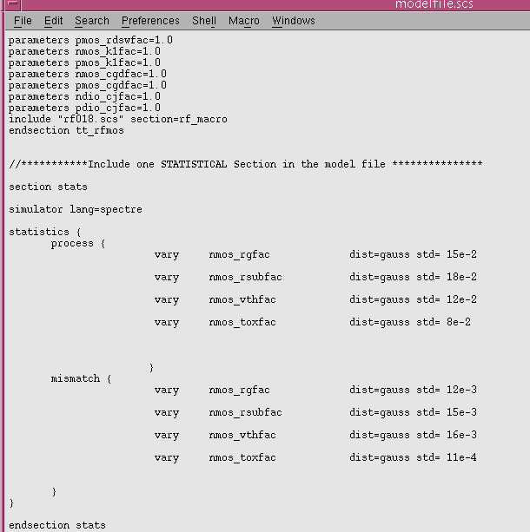
Monte Carlo simulation
Defining process,mismatch parameter as statistically assigned value
Process Section
Assesses the device mismatch on different die, which could have gone through some different process parameters during fabrication.
Variation defined as a distributed function
Assesses the device mismatch on same die,which could have gone through some different process parameter.
Cadence simulation setup (Monte Carlo)

Slide 12
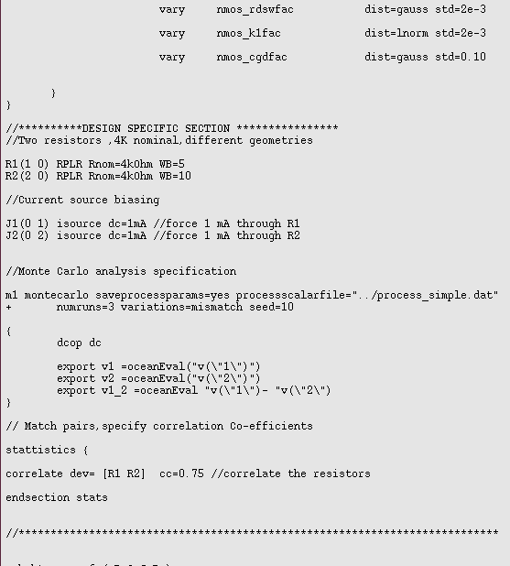
Monte Carlo simulation
Design Specific Section
This includes the circuit connectivity(two resistors, and corresponding current sources that feed them)
Defining correlation between two devices(R1,R2) †
Note :Alternatively this information can also be inserted through Artist Monte Carlo Tool.
Cadence simulation setup (Monte Carlo)

Slide 13
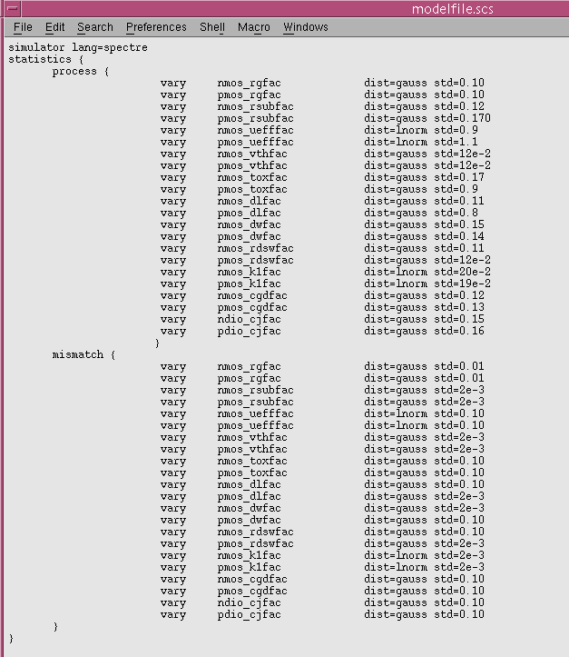
Monte Carlo simulation
Model file used for LNA example
Note→This is not based on foundry data but modeled for illustrative purposes.
Cadence simulation setup (Monte Carlo)

Slide 14
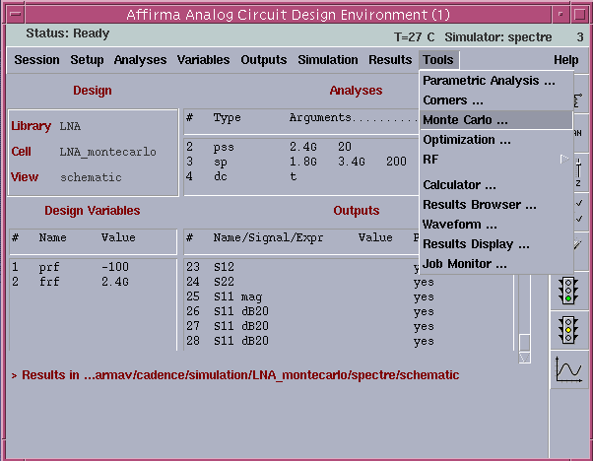
Monte Carlo simulation
After Initial design that meets the system requirement,statistical analysis must have to be carried out.
Make sure the addition of process and mismatch parameter section in model file.
Make certain to include the particular section (for exa.Stats in spectre) in simulation model library
Go to tool→Monte Carlo in affirma analog artist
Cadence simulation setup (Monte Carlo)

Slide 15
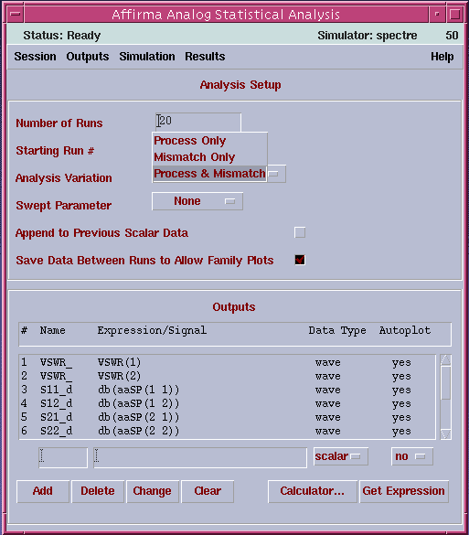
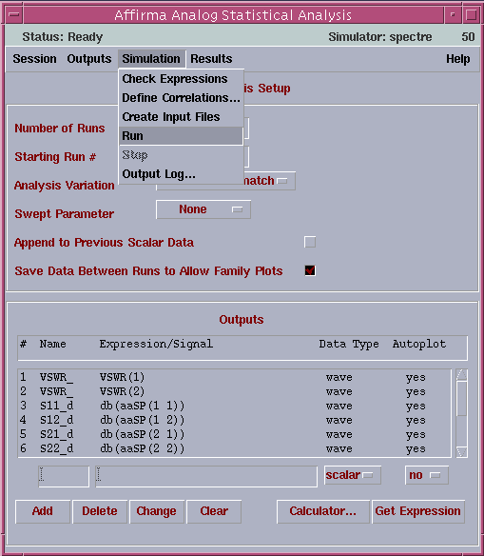
Monte Carlo simulation
Choose no of iteration(default=100)
1.Choose which variation to include
Process→device mismatch effect on two diff.die
Mismatch→device mismatch effect on same die
Finally run the analysis
2.Click if you want to see the family of curve i.e. curve from each iteration
3.Define the expressions / signals on which Monte Carlo analysis will be performed.
Note: calculator can also be used to get these expression
Cadence simulation setup (Monte Carlo)

Slide 16
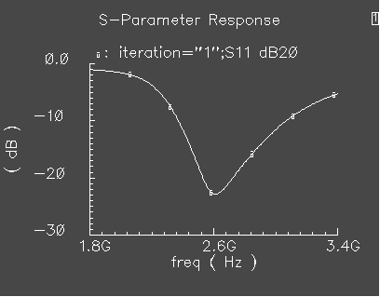
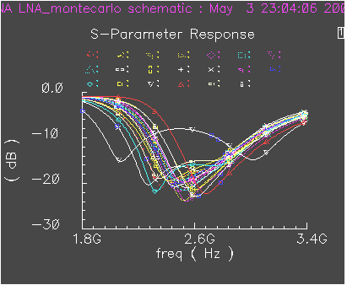
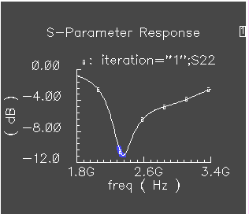
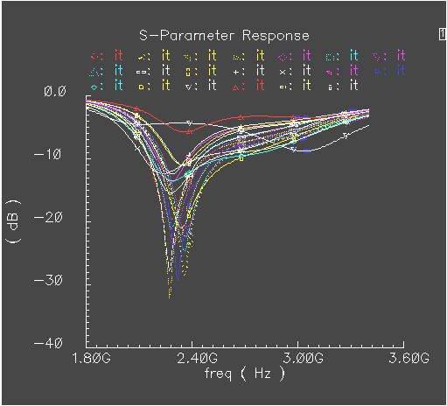
Monte Carlo simulation
(Analyzing waveform)
Matching
S11
Process parameter and mismatch effect
DEGRADES
Input & Output matching N/W
S22
DEGRADES
Overall design performance (noise,gain etc.)
Normal simulation (without statistical variation)
Monte Carlo Simulation (with statistical variation)

Slide 17
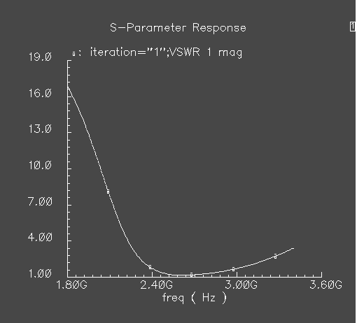
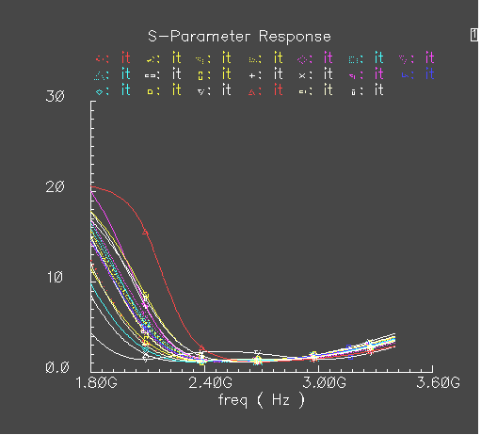
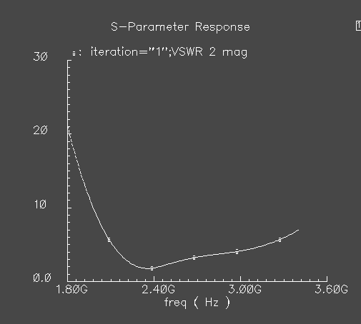
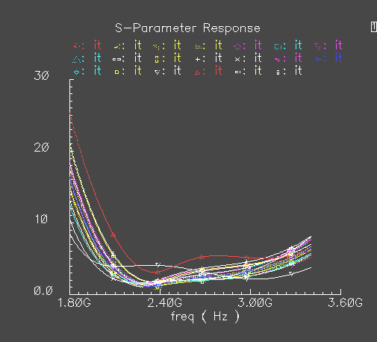
Monte Carlo simulation
(Analyzing waveform)
Matching(VSWR):It tells how well input and output N/W are matched.
VSWR1
Variations in VSWR
VSWR2
Normal simulation
Monte Carlo simulation

Slide 18
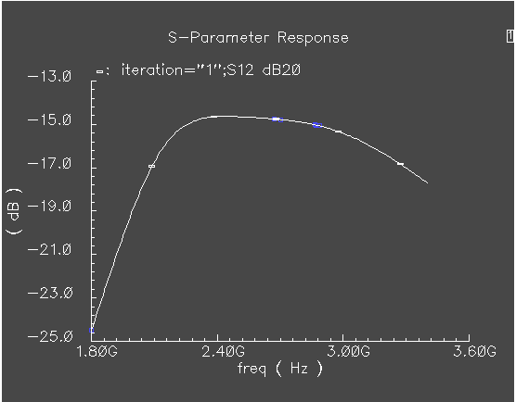
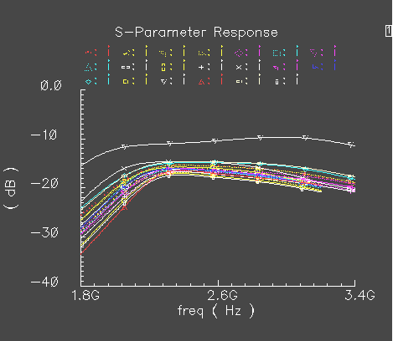
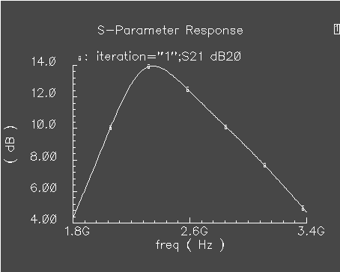
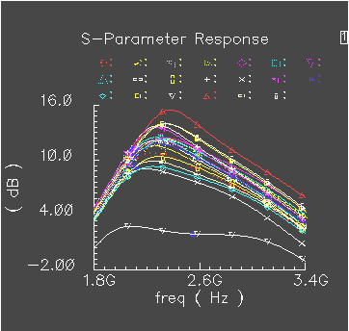
Monte Carlo simulation
(Analyzing waveform)
Matching(forward and reverse transmission gain)
S12
It has deteriorated the performance significantly, as a minimum S12 and maximum S21 value is desirable.
S21
Normal simulation
Monte Carlo simulation

Slide 19
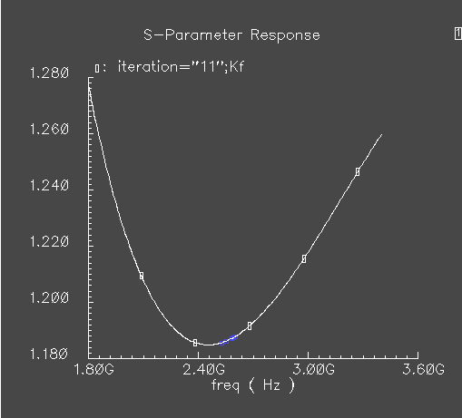
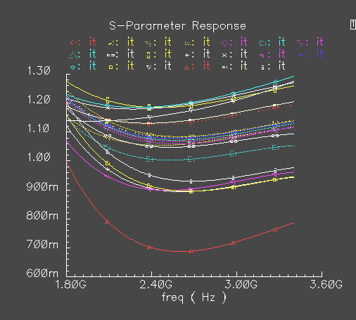
Monte Carlo simulation
(Analyzing waveform)
Stability:A Kf value >1,is desired for an stable amplifier
Kf value has become <1,and consequently creating a potential unstability,hence a large margin is required at initial design phase.
Stability factor
Normal simulation
Monte Carlo simulation

Slide 20
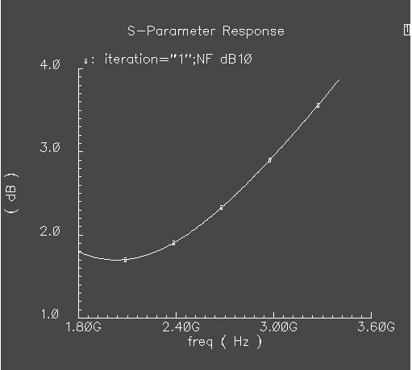
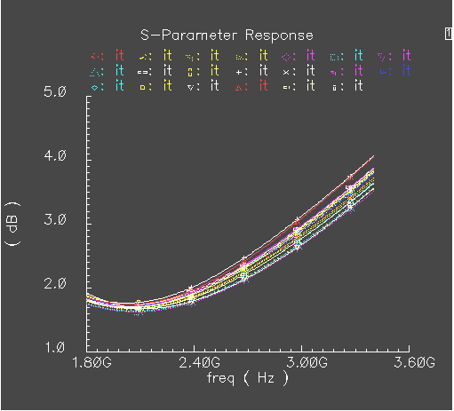
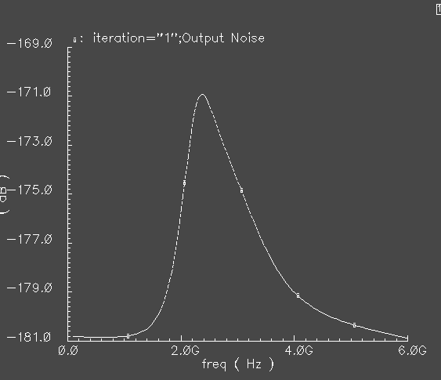
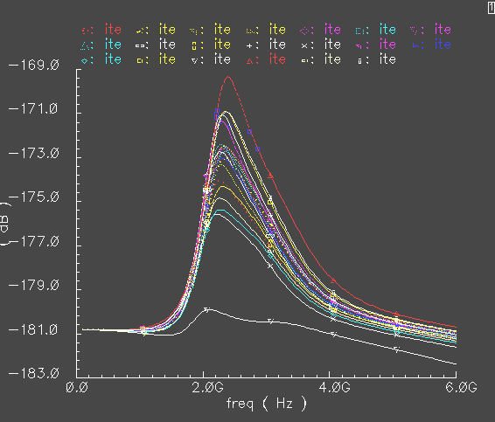
Monte Carlo simulation
(Analyzing waveform)
Noise Performance
As visible, design has a robust noise performance at desired band(2.4-2.5 GHz) BUT….→
Noise figure
Periodic Output noise
Normal simulation
Monte Carlo simulation

Slide 21
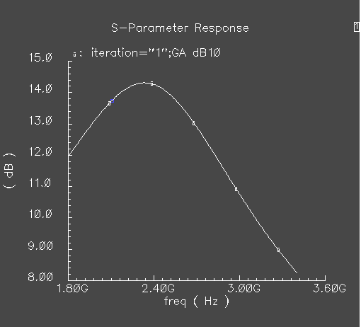
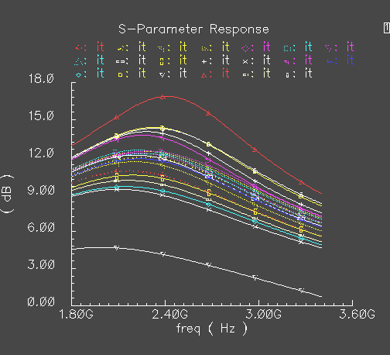
Monte Carlo simulation
(Analyzing waveform)
But…→ LNA as an RF-front end has to provide enough gain with maximum noise suppression to maintain an allowable SNR at demodulator's input.
It fails to meet the gain requirement
Gain

Slide 22
Monte Carlo simulation
We will quickly go over another example of low pass filter and see how to analyze scalar data and yield through Monte Carlo simulation

Slide 23
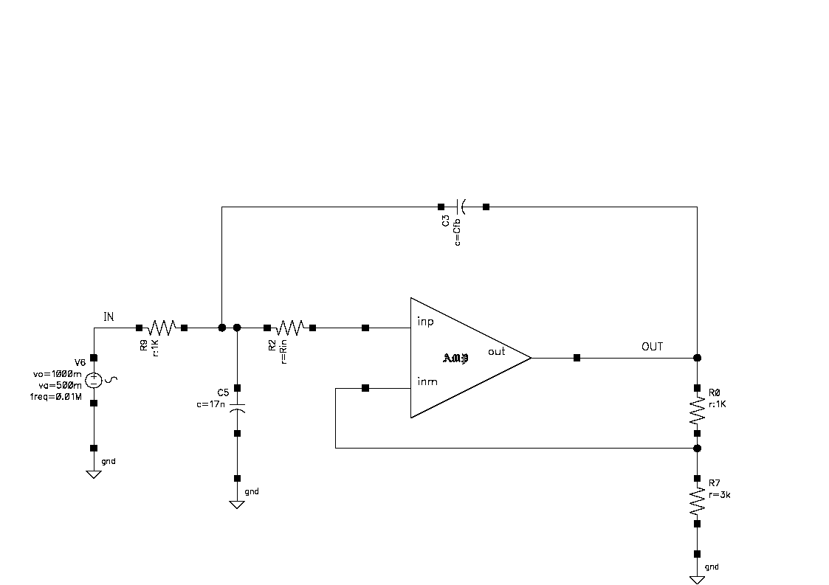
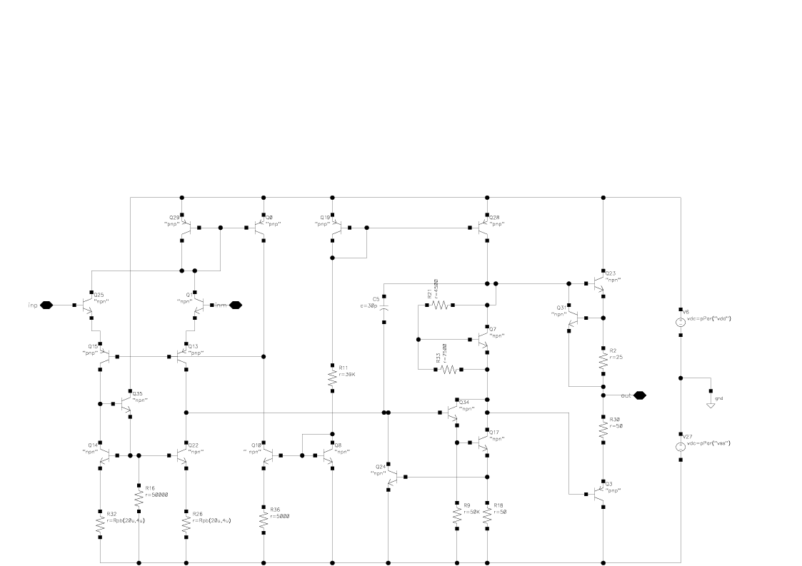
Monte Carlo simulation
Low-Pass Filter
Initial Design:
Circuit designing according to system requirement

Slide 24
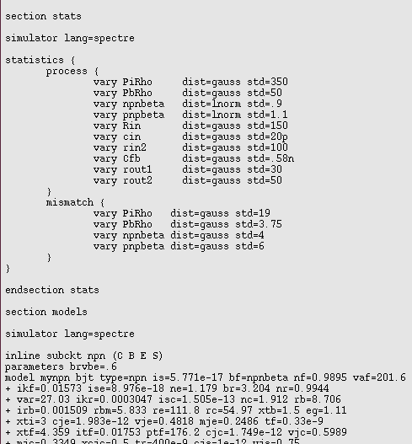
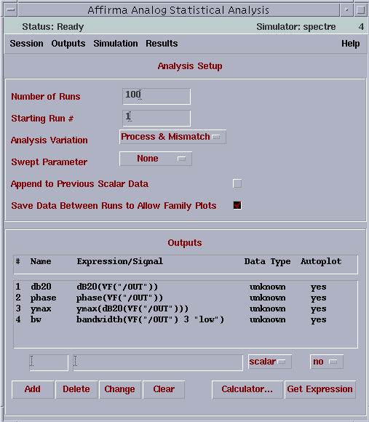
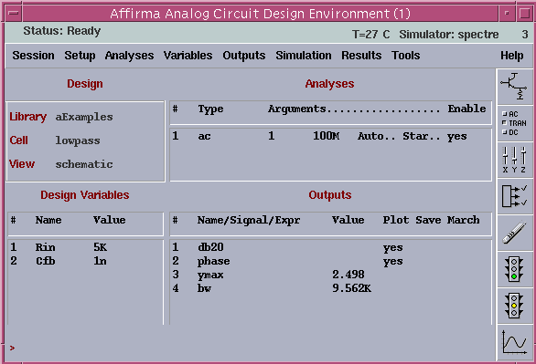
Monte Carlo simulation
1.Running normal analysis
2.Specifying statistical variation in model file
3.Running Monte Carlo analysis
1
2
3
Cadence simulation setup (Monte Carlo)

Slide 25
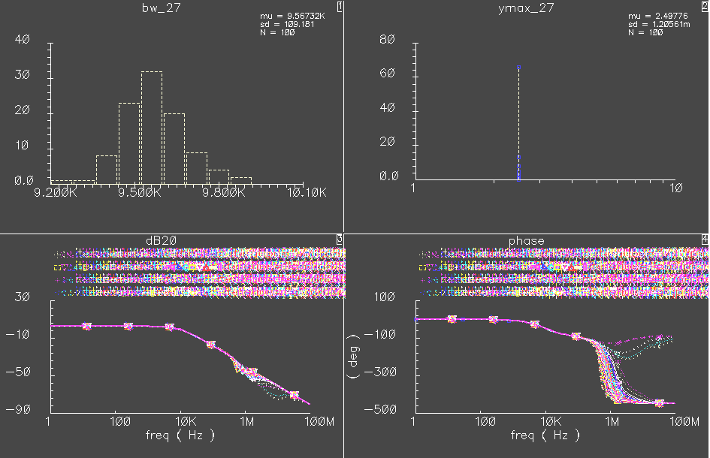
Monte Carlo simulation
(Analyzing results)
Simulation shows db20 and phase values are greatly affected by statistical variations introduced in transistor. Hence the need for redesigning the circuit

Slide 26
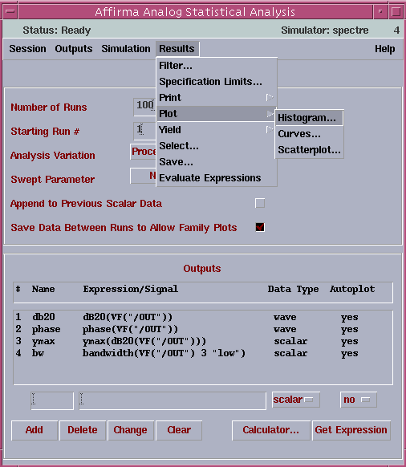
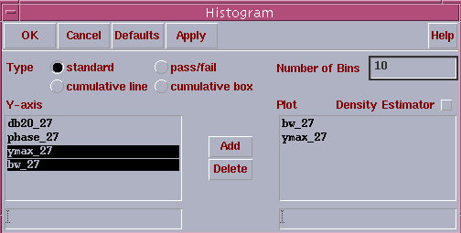
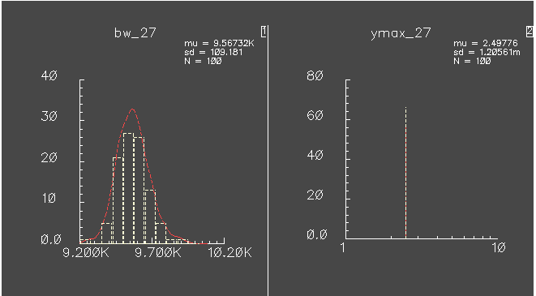
Monte Carlo simulation
(Analyzing Scalar data)
1.Choose results→plot→ Histogram
2.Choose parameters to plot
3. Analyze the histogram appeared in waveform window

Slide 27
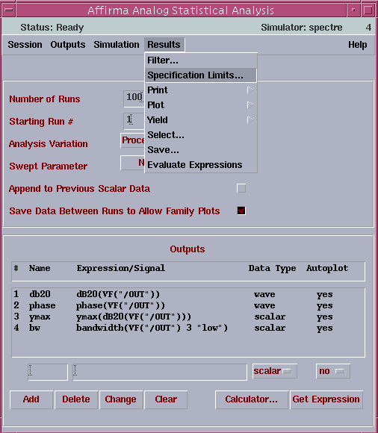




Monte Carlo simulation
(Analyzing Yield)
1.Choose results→ specification limits
2.Set bounds and limits
3.Choose Results→ yield → simple in analysis window
4.Set suppression value for yield
5.Analyze yield
Only 64% iterations passes the specified limits for bandwidth and ymax

Slide 28






Monte Carlo simulation (PLL Components)
Overview
• Phase/frequency detector determines the difference between the phase or frequency of two signals
• The loop filter removes the high-frequencies from the voltage-controlled oscillator (VCO) controlling voltage
• The VCO produces and output frequency controlled by a voltage
Reference clock
Detector output
Loop filter response
Oscillator output
Clock divider output

Slide 29



Monte Carlo simulation (PLL Components)
Noise Sources
In PLL design it is highly desirable to be able to see the impact of all noise sources,which in turn affects the overall PLL performance.
Due to variation in control voltage
Due to reference jitter
Detector noise
VCO noise
Σ-Δ Quantization noise
Due to uncertainty involved in discretization

Slide 30


Monte Carlo simulation (VCO)
An oscillator is a circuit capable of maintaining electric oscillations.
Frequency of oscillation =1/(LC)^{1/2}
Controlled by voltage dependent capacitance (varactor)
Complimentary Cross-Coupled LC VCO
Power efficient since bias current is shared between the two transconductors.
equivalent
For operation in current -limited regime:
VO = (4/π) .I_{bias}.R_{eq} (Ideal switching)
VO(apx) = I_{bias}.R_{eq} (High frequency)

Slide 31

Monte Carlo simulation (VCO – Phase Noise)
Causes of spectral purity degradation (phase noise):
1.) Random noise in the reference input, the PFD, loop filter and VCO (also dividers if the PLL is a frequency synthesizer)
2.) Spurious sidebands – high energy sidebands with no harmonic relationship to the generated output signal. It is systematic in origin.
Why is spectral purity important?
Phase noise can degrade the
sensitivity of a receiver due to
reciprocal mixing
Phase noise produces adjacent
channel interference
Notes:
First figure- there are one desired signal @Frf and also one unwanted signal (say @ Fuw) in the vicinity.
Second figure- output spectrum of VCO is not pure (if it is pure then it will have only single impulse @Flo that means pure sinusoid). Apart from other spurious noise and variation in control voltage VCO accumulates some unwanted phase thus results in a spectrum rather than a single impulse
Third figure- Here desired rf signal is being downconverted to the intermediate frequency. Fif= Frf-Flo, but in frquency band unwanted signal is also getting downconverted @Fuw – Flo . Since the closeness mixing of spectrum occurs which result in sensitivity degradation.
Desird signal is at f2 but in the vicinity(f1) there is a transmitter which has a bad phase noise and crosses the channel separation limit. So at f2 nearby transmitter also have some signal power.

Slide 32
Monte Carlo simulation (VCO – Phase Noise)
How do the process and mismatch variation affect phase noise?
-- we will perform monte carlo analysis to assess this.
Step1 –Varying the process parameter only
Step2 – investigating the device mismatch(in diff VCO one side mismatched to the other) in presence of process variation
Cadence Spectre modeling:
The statistics block contains the distributions for parameters:
Distributions specified in the process block are sampled once per Monte Carlo run, are applied at global scope, and are used typically to represent batch-to-batch (process) variations.
Distributions specified in the mismatch block are applied on a per-subcircuit instance basis, are sampled once per subcircuit instance, and are used typically to represent device-to-device (on chip) mismatch for devices on the same chip.

Slide 33

Monte Carlo simulation (VCO – Phase Noise) model file
Process section
Define statistical blocks in the model file (ideally it should be provided from the foundry)
Mismatch section

Slide 34


Monte Carlo simulation (VCO – Phase Noise)→STEP-1
Running Monte Carlo for process variation only
With applied statistical variation(in model file) an increase in noise can be observed, and at this run resulted noise is worst and unacceptable.
Normal simulation
Monte Carlo simulation

Slide 35

Monte Carlo simulation (VCO – Phase Noise) →STEP-2
Running Monte Carlo for mismatch in 2 sides of Diff. VCO
Again similar looking but not the same results appears and noise at this run is unacceptable .
Normal simulation
Monte Carlo simulation
Note: When the same parameter is subject to both process and mismatch variations, the sampled process value becomes the mean for the mismatch random number generator for that particular parameter.

Slide 36

Monte Carlo simulation (VCO – Phase Noise)-- more insight
To get more insight we will vary only few parameter and check how values are assigned for different run as well as the simulation result
Defining variation for only two parameters in the model file -→
-Vth
-tox

Slide 37

Monte Carlo simulation (VCO – Phase Noise)-- more insight
Process variation only
PM1
PM0
NM1
NM0
Here both nmos (pmos) transistors have been assigned same process variation.In each run they take on different parameter according to distribution defined

Slide 38

Monte Carlo simulation (VCO – Phase Noise)-- more insight
Process and Mismatch both variation together,with correlation of 0.2 between the two nmos(pmos) transistor
As conspicuous each nmos(pmos) transistor is getting different parameter value in each run.

Slide 39


Monte Carlo simulation (VCO – Phase Noise)-- more insight
As visible in the case of process variation with device mismatch noise has been increased.
Process variation only
Process & mismatch variation

Slide 40

Monte Carlo simulation (PLL at a glance)
In a PLL all these process variation can degrade it’s overall performance significantly. To see the impact of process variation we probe the output after the loop filter.
As clear in one case control voltage (i.e. loop filter output) is ramping rapidly compare to other and thus will result in different performance.
Monte Carlo simulation

Slide 41
Monte Carlo simulation
In our design PLL has a settling time of 65 us.To simply run the analysis(transistor level) for this much period may take 2-3 days on a single machine.
To do monte carlo simulation even for 10 run will make the situation worse.
To speed up Monte Carlo analyses—to make them run in minutes as opposed to days—
--We need to reduce the run time and can utilize Parallel simulation.
--Such as variance reduction technique can be employed.

Slide 42

Monte Carlo simulation (Seed no & parallel simulation)
Seed
If Monte Carlo simulation for different seed is required then…..
Step 1.Create netlist(input file)
a)Either from analog artist or
b)Tools→ monte carlo → simulation→create_input_files
Note:
(1) Input file should have ‘.scs’ extension (for exa.input.scs)
(2)In spectre one can not specify different seed from GUI(by default it always takes seed=1).

Slide 43


Monte Carlo simulation
Monte Carlo simulation (Seed no & parallel simulation)
Seed
Step 2.
Edit input.scs file manually→
edit SEED=? line
(number you want)

Slide 44
Monte Carlo simulation
Monte Carlo simulation (Seed no & parallel simulation)
Seed
Step 3.Run spectre from command line with option for example…..
spectre -env artist4.4.6 +log ../psf/spectre.out -format psfbin -raw ../psf input.scs
Here one should execute spectre command(or executable file) from the netlist directory.
For example one wants to simulate “PLL” design from command line
Then go to your simulation directory
cd …/simulation/pll/spectre/schematic/netlist
and here execute spectre command

Slide 45



Monte Carlo simulation
Monte Carlo simulation (Seed no & parallel simulation)
Seed
Step 4.Results can be plotted with either from calculator or from Monte Carlo tool…..
Seed=1
Seed=3
Fig:Plots for different seed value simulation
Seed=11

Slide 46

Monte Carlo simulation (Seed no & parallel simulation)
A way around from GUI
Another way of doing similar thing(giving different seed value) from GUI would be to start simulation from different run,or say to skip some initial run as shown in the fig.
Here it will skip first 10 runs and simulate from 11’th to 110’th run for 100 iteration
This is quite similar to assigning different seed value.
But beware skipping these runs could take much longer time for a complex design

Slide 47

Monte Carlo simulation (Seed no & parallel simulation)
Running multiple analysis from one file
This can be done by defining multiple monte carlo analysis statement in the input file as shown below
Analysis 1
Analysis 2
Note: For each analysis a different name to child analysis(for example ac,dc,tran) and to output file has to be assigned.

Slide 48

Monte Carlo simulation (Seed no & parallel simulation)
Running script for executing multiple files (sequentially)
This can be done by making an executable file as shown and running it from command window
These file can be used to simulate different design as well as same design (with different seed value in it)
NOTE:In all cases spectre command(or executable file) must be excited from the netlist directory.

Slide 49
Monte Carlo simulation (Seed no & parallel simulation)
Parallel Simulation
One can easily set up queues, where a particular queue is set up using the built in Cadence"LBS" system.
1.Create a configuration file:
queueName numberOfMachines machine1 numberOfJobs machine2 numberOfJobs
queue2 numberOfMachines ...
e.g. parallelQueue 1 linuxMachine 4
2. Pick a machine as your queue manager, and then run:
cdsqmgr /path/to/the/queue_config
3. Before running DFII, do:
setenv LBS_CLUSTER_MASTER queueMachineName
where queueMachineName was the machine you ran cdsqmgr on.
4. Then one can submit Artist jobs as "distributed" as shown in the …….next slide

Slide 50


Monte Carlo simulation (Seed no & parallel simulation)
Parallel Simulation
Setting for distributive processing
1.from analog artist go to
2.set distributive and assign jobs to all machine

Slide 51
Monte Carlo simulation (Seed no & parallel simulation)
References:
1.Lecture notes of Michael Perrott Massachusetts Institute of Technology.
2. Lecture notes of Phillip Allen Georgia institute of technology.
3. Cadence Spectre user guide.
4. Inputs from Andrew Beckett, cadence Inc.

